Slide 1
CREATE TABLE PARTITION.
Milind Parab

Slide 2
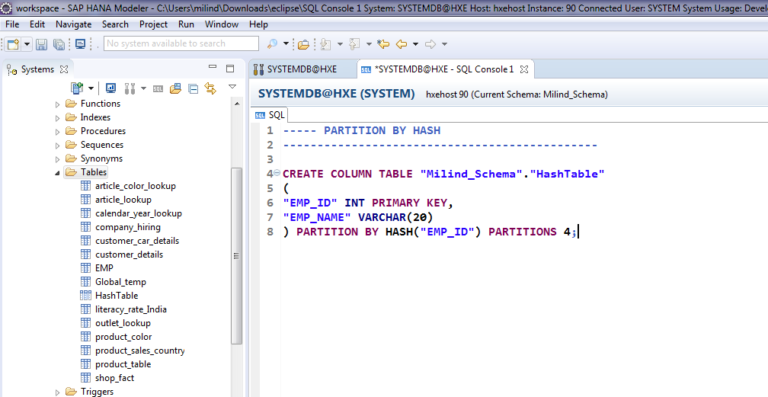
Hash Partition.

Slide 3
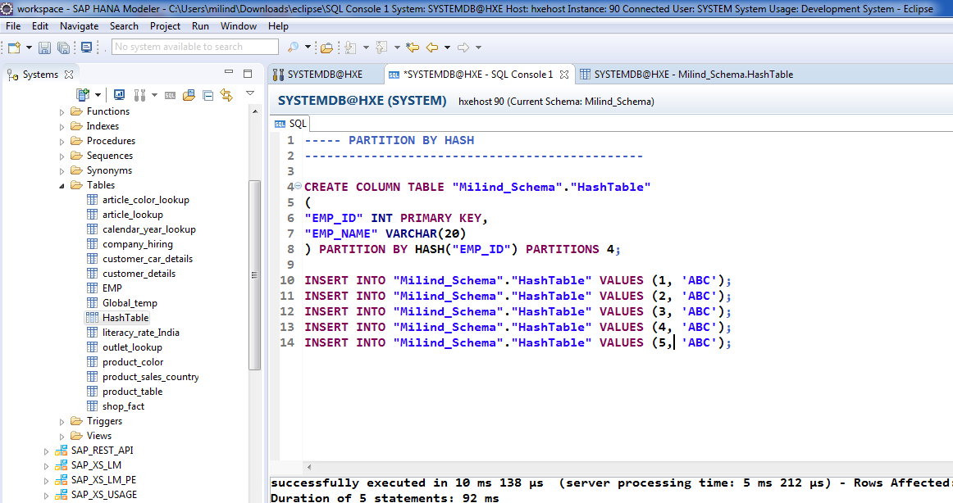
Insert data into Hash Table.

Slide 4
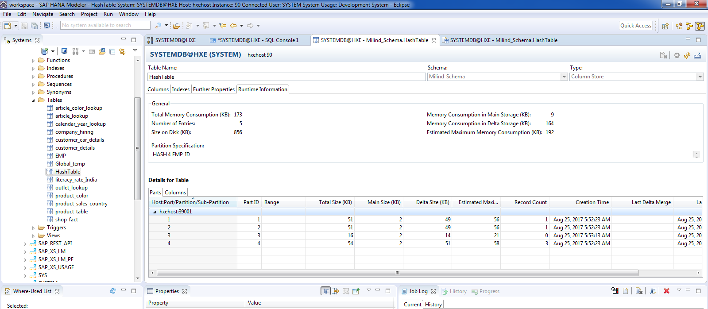
Check Runtime Information.

Slide 5
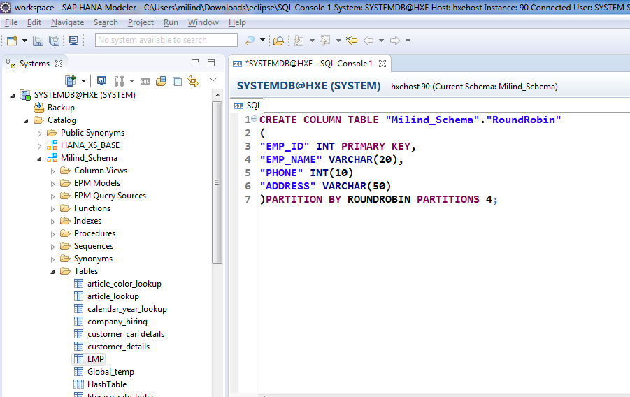
Partitions by round robin.

Slide 6
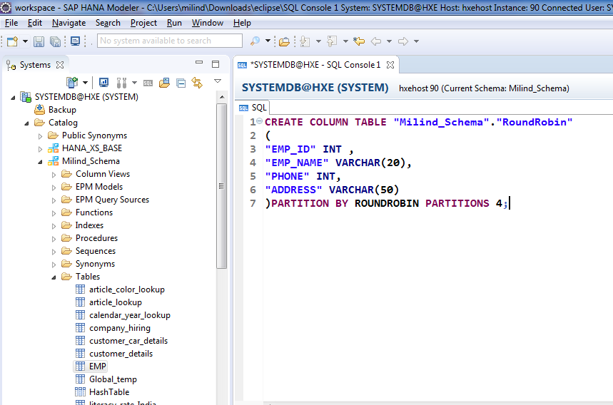
Cont.

Slide 7
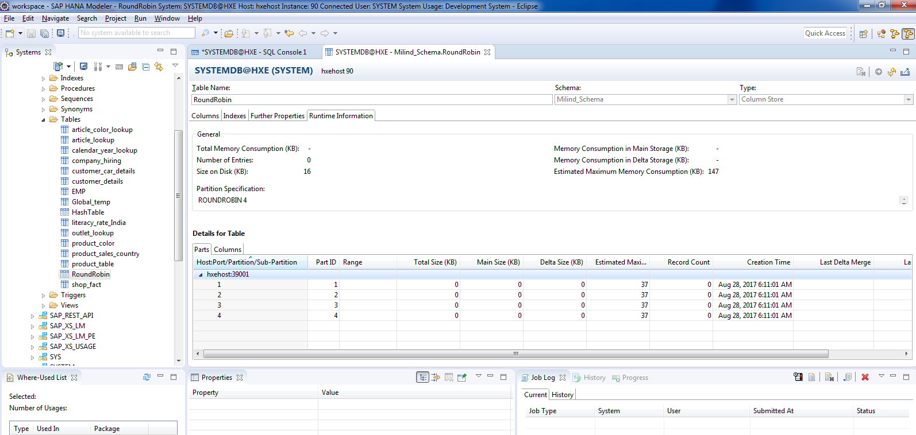
Cont.

Slide 8
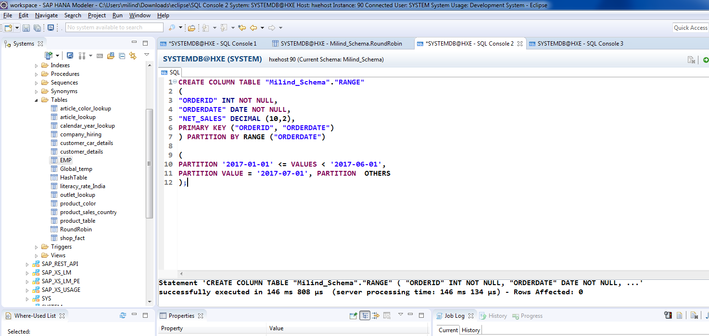
Partition by Range.

Slide 9
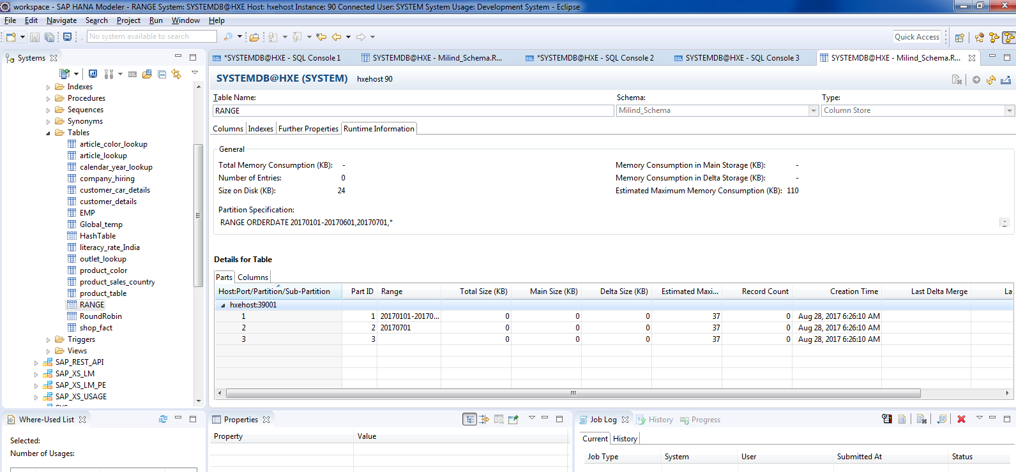
Cont.

Slide 10
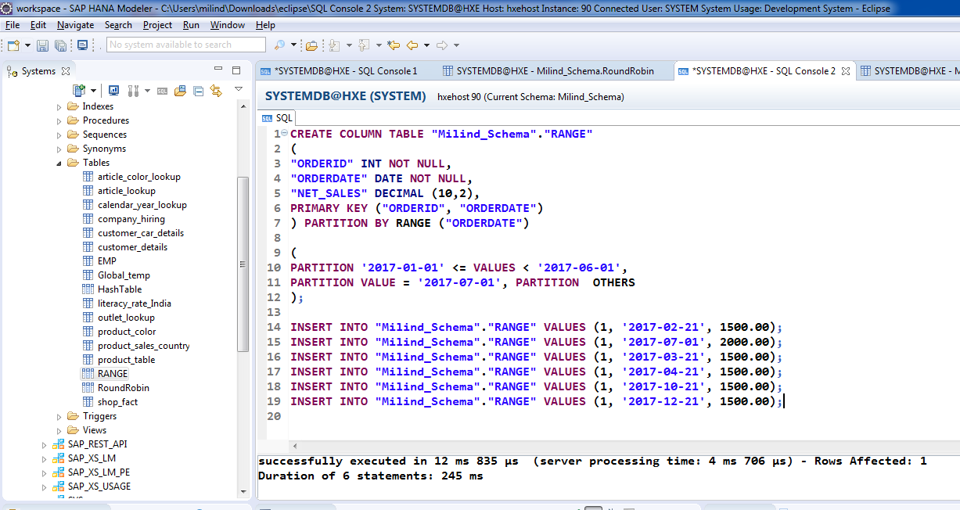
Cont.

Slide 11
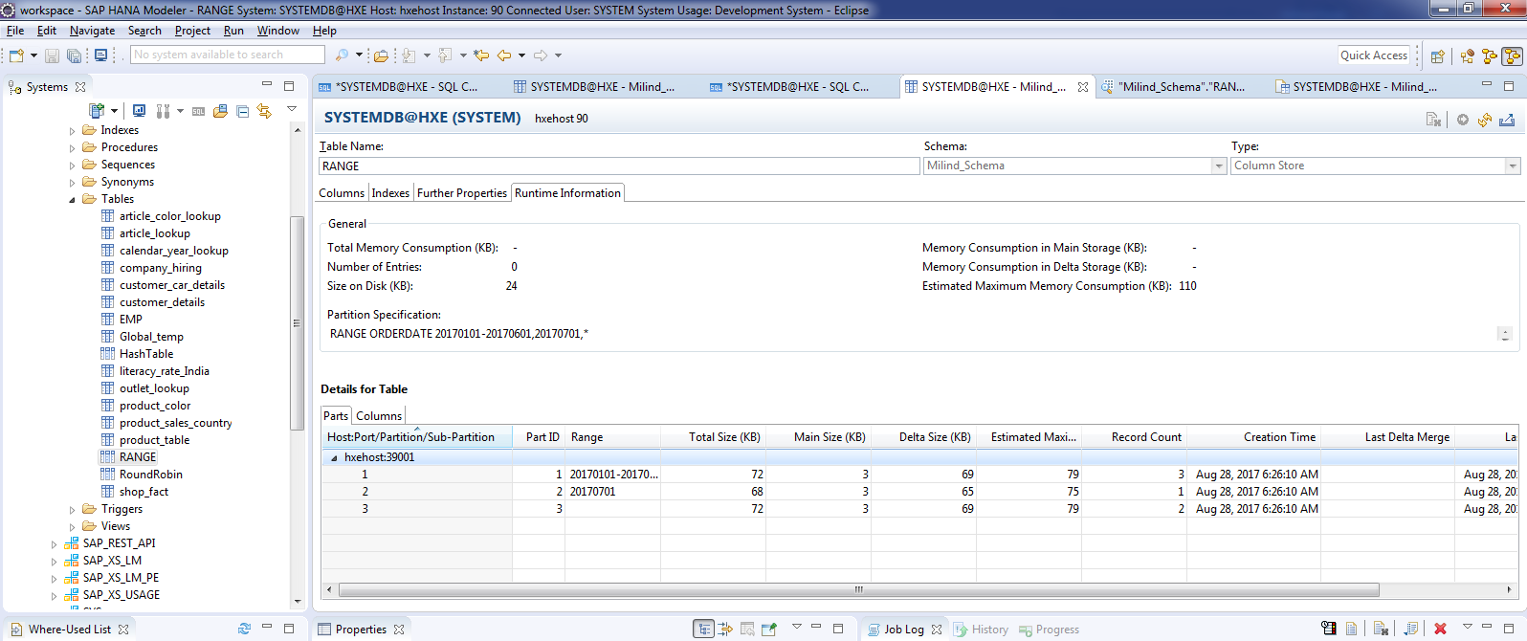
Cont.

Slide 12
Cont.
If you delete the table, all partitions will be deleted.
Range partition can be only created using Primary Key.

